Slide 1
Object Detection and Localisation Lab
Introduction
U. Michelucci
11.10.2022
Informatik

Slide 2
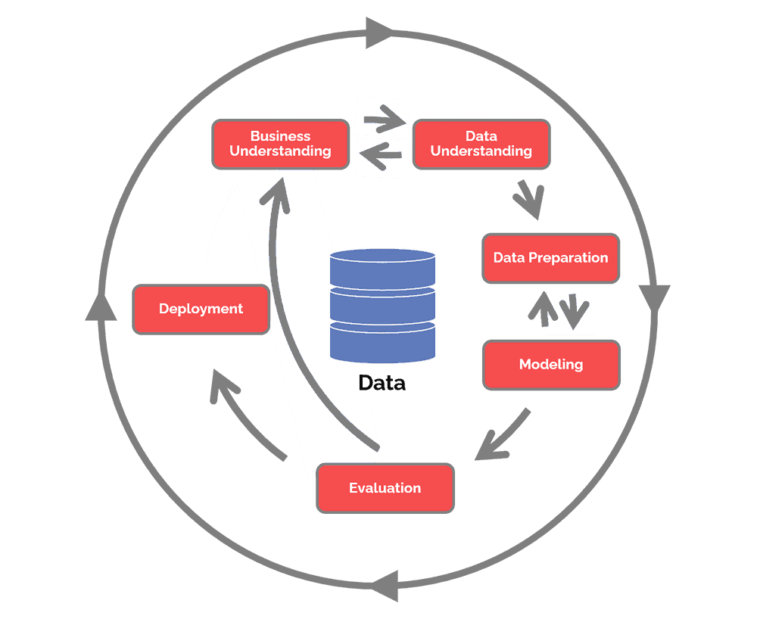
Project Phases: CRISP-DM
Quelle: ttps://www.datascience-pm.com/crisp-dm-2/

Slide 3
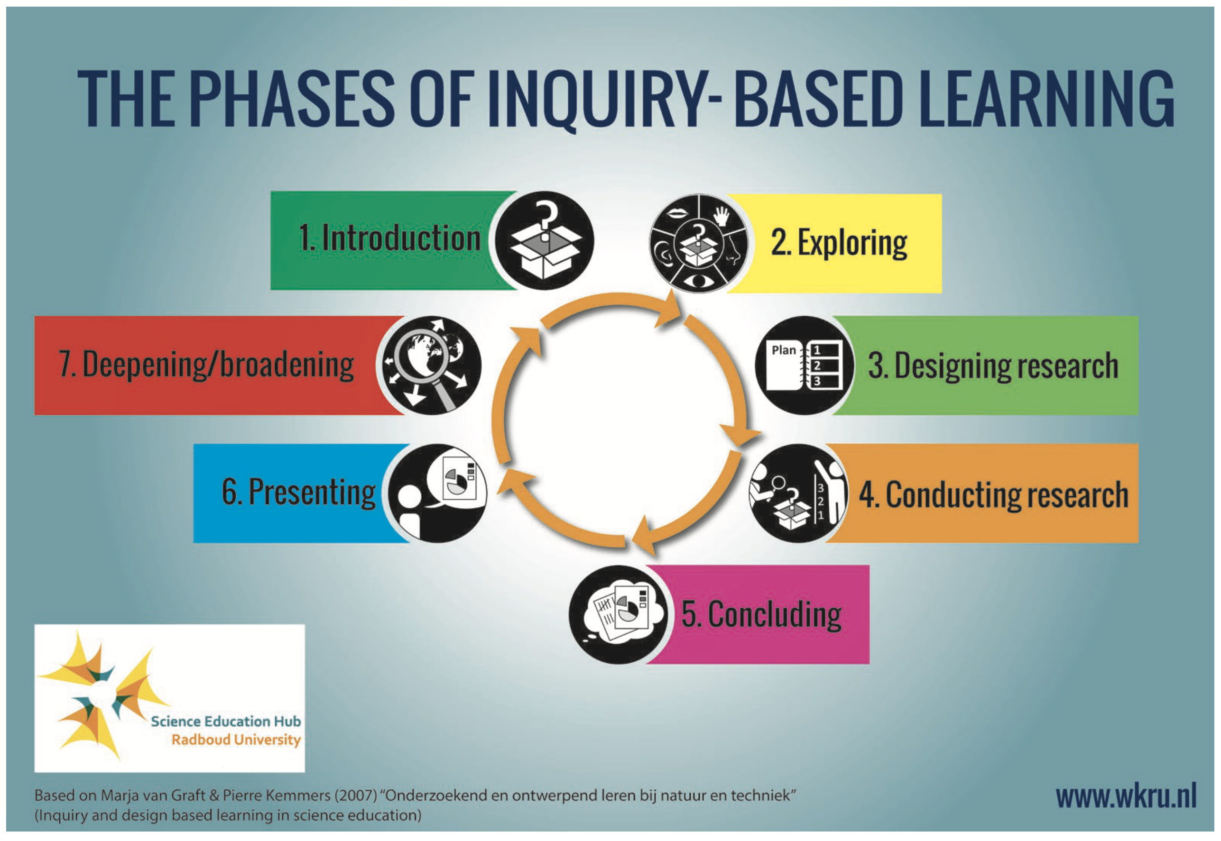
Project Format: Enquiry Based Learning
17.11.2022
Week 1
Data Loading and preparation.
17.11.2022
Week 1
17-24.11.2022
Week 1-2
Modelling and Evaluation
1.12.2022
Week 3

Slide 4
Project Rules
Work in groups of 2
Everything is allowed (google search, overflow, discussing with your peers, asking questions, etc.)
Decision must be met by YOUR GROUP.
There is NO wrong decision. It all depends on the research question you want to ask.
You can continue to work on the project home (you should really)
Presentation is important. Prepare for it.

Slide 5
Project Deliverables and % of evaluation
Research question formulation and teamwork (20%)
Jupyter notebook (or Python script) for data preparation and analysis (20%)
Jupyter notebook (or Python script) for modelling and evaluation (20%)
Presentation about the results (40%)
Things that will make us like your work even more:
A complete GitHub repository with good documentation of the project that you would be proud to show your future employer.
A well done overfitting analysis of the models you have trained.

Slide 6
The Problem

Slide 7

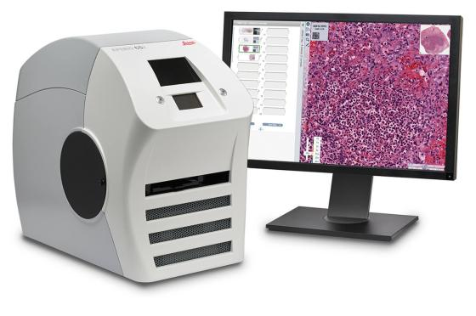
This data set represents a collection of textures in histological images of human colorectal cancer.
All images are RGB, 0.495 µm per pixel, digitized with an Aperio ScanScope (Aperio/Leica biosystems), magnification 20x. Histological samples are fully anonymized images of formalin-fixed paraffin-embedded human colorectal adenocarcinomas (primary tumors) from our pathology archive (Institute of Pathology, University Medical Center Mannheim, Heidelberg University, Mannheim, Germany).
This data set represents a collection of textures in histological images of human colorectal cancer. It contains two group of files (ZIP File in ILIAS):
"Kather_texture_2016_image_tiles_5000.zip": a zipped folder containing 5000 histological images of 150 * 150 px each (74 * 74 µm). Each image belongs to exactly one of eight tissue categories (specified by the folder name).
"Kather_texture_2016_larger_images_10.zip": a zipped folder containing 10 larger histological images of 5000 x 5000 px each. These images contain more than one tissue type.
Quelle: https://zenodo.org/record/53169#.Y3R-ty8w3Lu

Slide 8
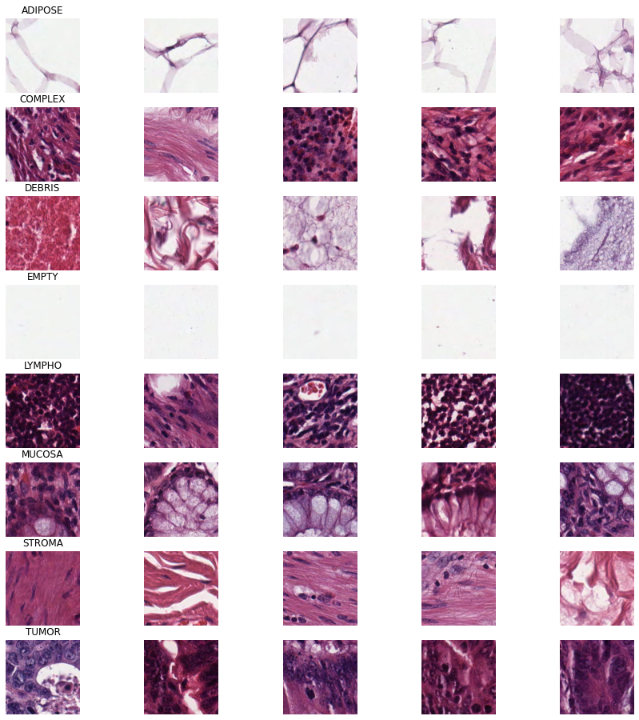
Adipose tissue, otherwise known as body fat, is a connective tissue that extends throughout your body
It is a kind of tissue that is made up of more than one type of cell, and all the cells coordinate to perform a common function.
Tissue present in a wound of different types.
The Data
Lymph Tissues are found at various points around the body, including the throat, armpits, chest, abdomen and groin
The moist, inner lining of some organs and body cavities(such as the nose, mouth, lungs, and stomach).
the supportive tissue of an epithelial organ, tumour, gonad, etc., consisting of connective tissues and blood vessels.

Slide 9
Main Research Question (your task)
Build a classifier to find TUMOR tissue.

Slide 10
Possible additional research questions (in order of difficulty)
(EASY) Build a classifier that distinguish between “TUMOR” images and a second type only. For example TUMOR vs. EMPTY or TUMOR vs. DEBRIS. Question: will be as easy to classify TUMOR vs. LYMPHO?
(MEDIUM) Classify all images in one of the 8 classes. But build a model that is NOT overfitting.
(MEDIUM) Use Transfer Learning to build a classifier for all 8 classes (you can use a pre-trained network to start).
(MEDIUM) Study what is the minimum resolution of images to get a fast model but a good one. Do you really need 150x150 pixels? Do you need to have colors? How does the model work in black and white?
(MEDIUM/HARD) Use Data Augmentation to train a model and lower the overfitting and increase the accuracy.
(MEDIUM/HARD) Can you classify the images by using the color distributions and not the image themselves? Are the results better or worse?
(DIFFICULT) If you solve question 2, can you use your classifier find where tumor issue is located in larger images?

Slide 11
Be careful
Things to pay attention to:
Overfitting (must be checked)
Accuracy is misleading. The confusion matrix is a better metric.

Slide 12
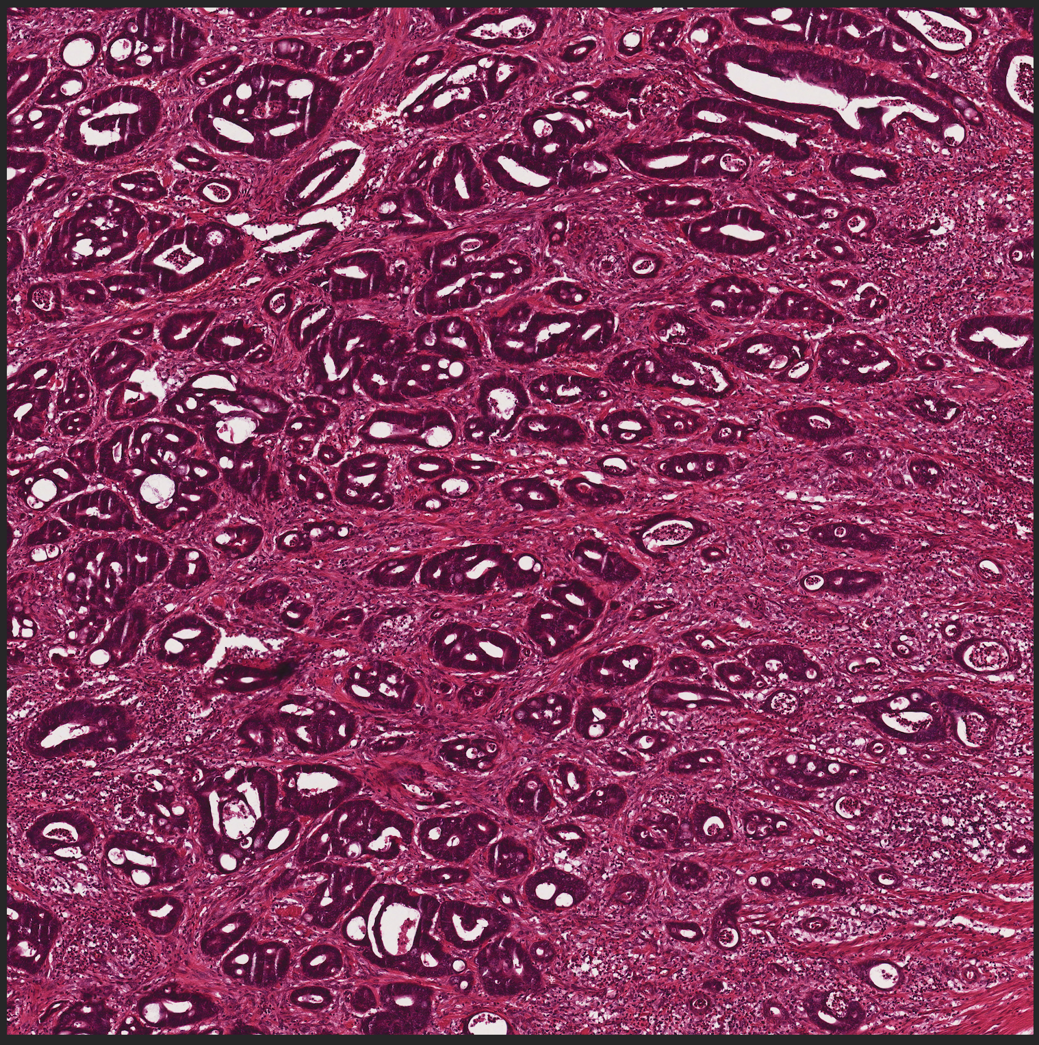
Large Images – Where is tumor tissue?

